Slide 1

to our presentation

Slide 2

Team members:
Free Thinkers
Md Mahamudul Hasan (221-15-6013)
Tamanna Akter(221-15-5298)
Department of CSE
Section : M

Slide 3
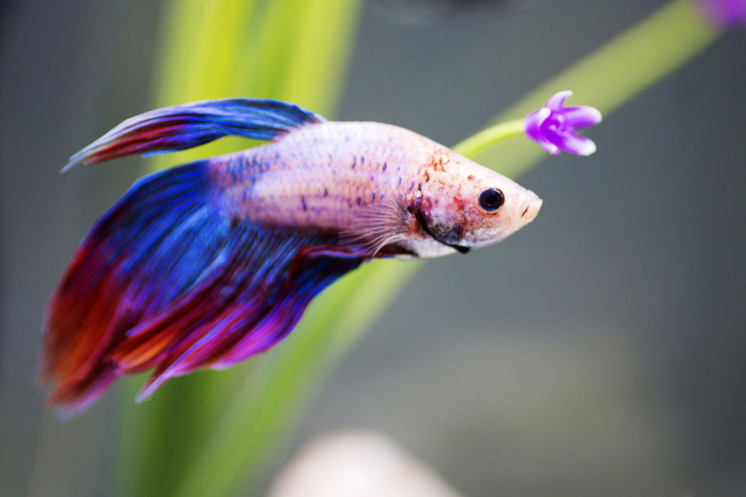

Fish kingdom
FISH KINGDOM​
Save money , stay funny

Slide 4

Problems:
Fish kingdom
Buyers hamper to find a reliable hatchery.
Quality minnow are difficult to find.
price is an important concern for customer buying fish.

Slide 5
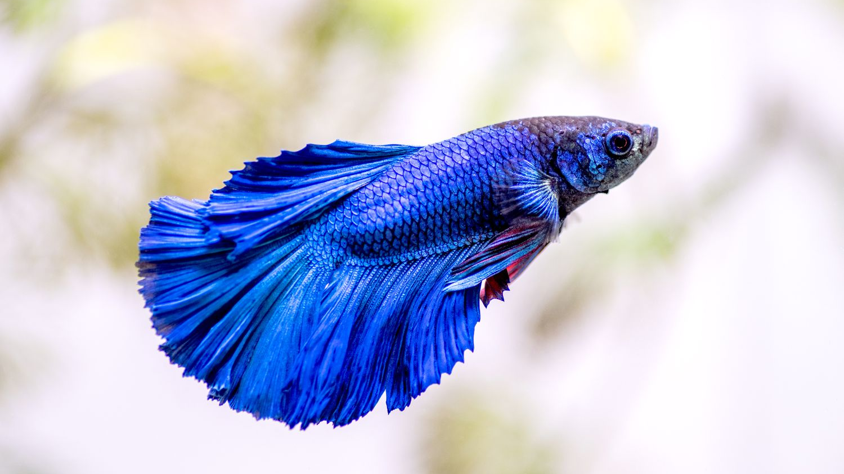



Solutions:
Fish kingdom
A online platform where buyer can buy their product easily.
Faithfulness
Pure products
Save money

Slide 6

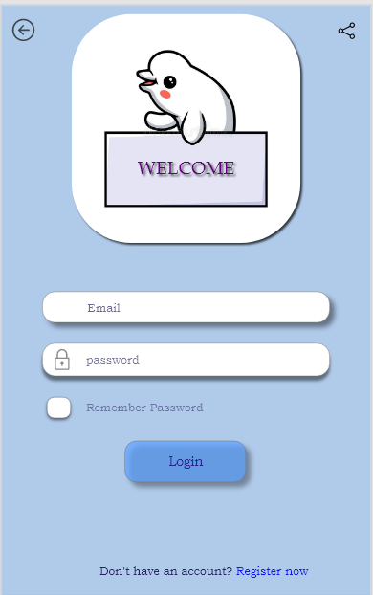
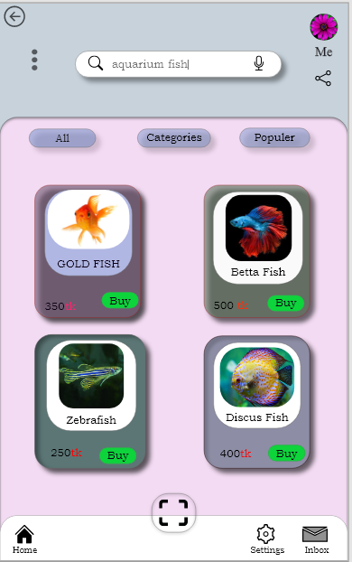
Prototypes:

Slide 7
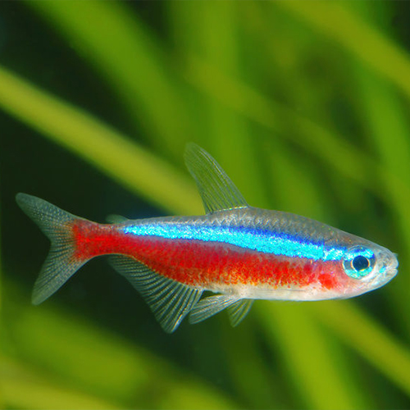
Fish kingdom
Total Market $40000
Serviceable Market $5000
Share Market $1000
Market size

Slide 8
Competitive Advantage
First to market
Easy of use
Quality of proudct
Easy to communication
Low cost
Fish kingdom

Slide 9
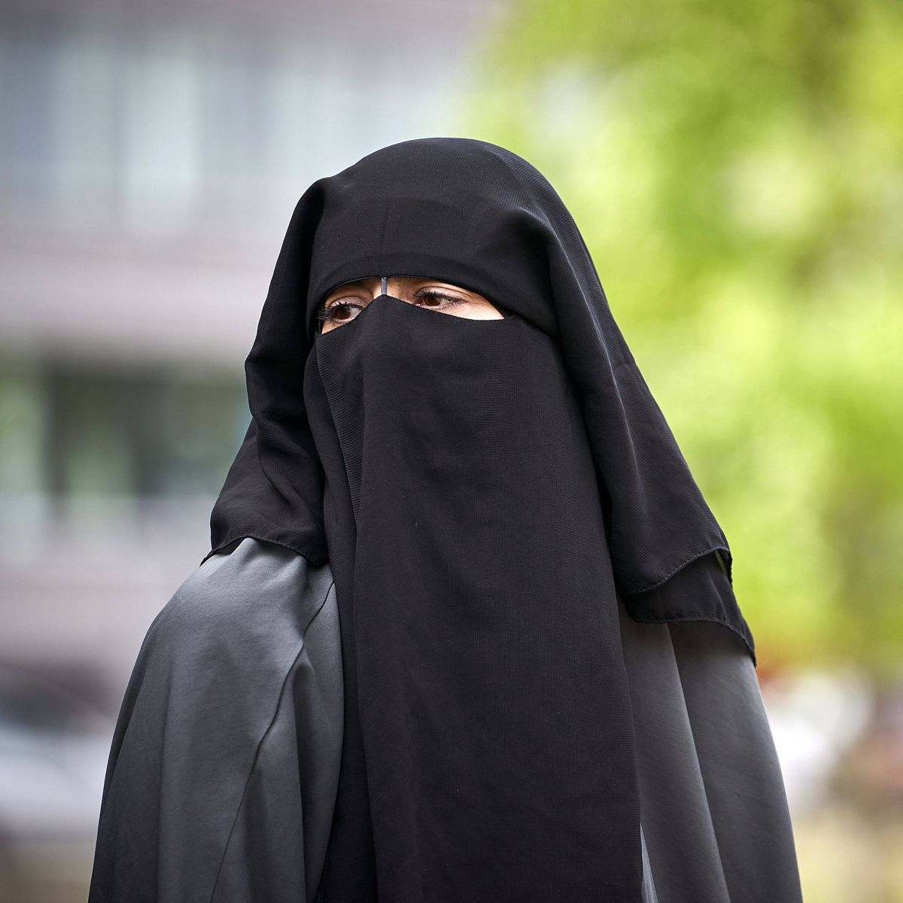
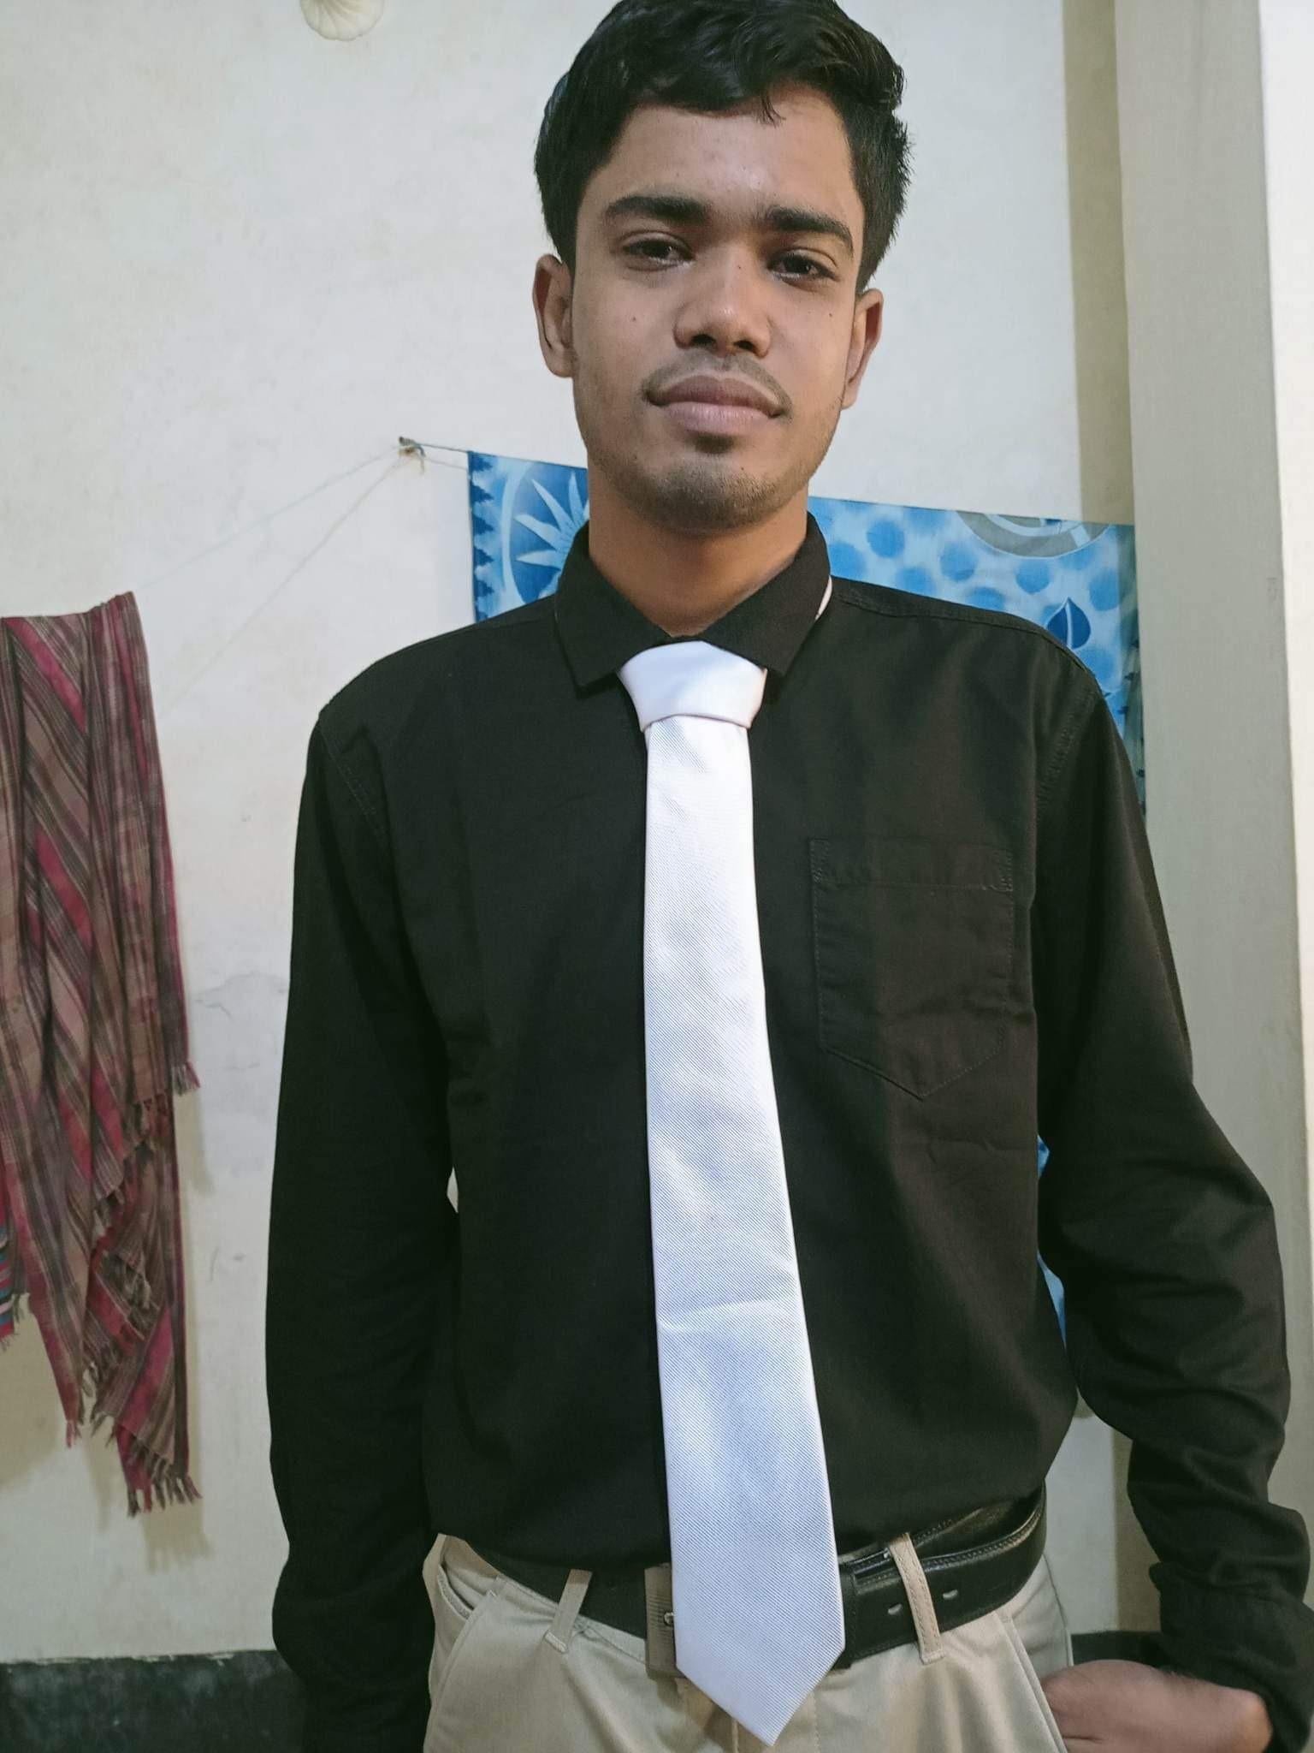
Team
Fish kingdom
Tamanna Akter
(Business planner & developer)
Md Mahmadul Hasan
(Marketing head)

Slide 10



Technology strategy

Slide 11

Business Strategy
Product Plan
Partnerships
Marketing plan
Sales plan

Slide 12







Financial strategy
Let's look at our annual financial transactions
2000
1890
2600
Capital
Cost
Revenue

Slide 13


